Slide 1

Learning Objective
I will graph linear relationships
Enter quietly, please be ready with the following on your desk:
Whiteboard
Whiteboard marker
Exercise Book
Pencil, pen, ruler and red pen
Diary
Calculator
Device – charged or borrowed from Library before maths

Slide 2
Learning Objective
I will sketch linear graphs
Success Criteria
I will be able to sketch graphs using the y-intercept and gradient
I will be able to sketch graphs using the x – and y-intercept
I will be able to sketch graphs using the y-intercept and one point

Slide 3
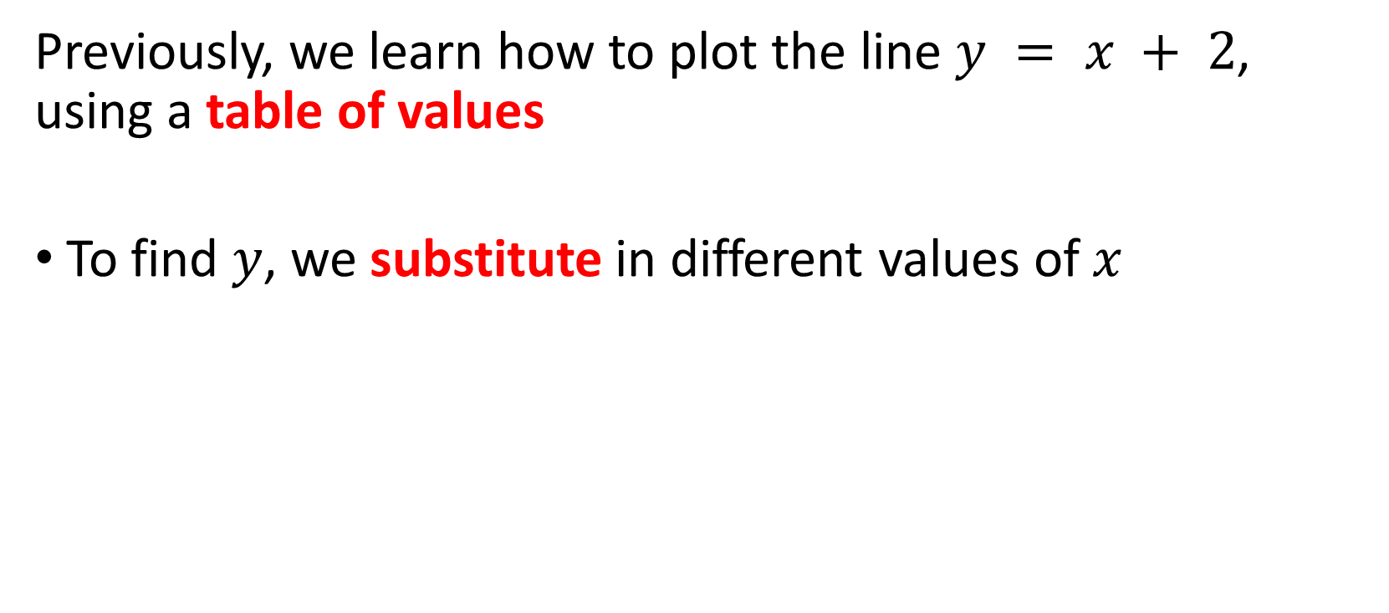
Activating Prior Knowledge
Previously, we learn how to plot the line $y = x + 2$, using a table of values
To find $y$, we substitute in different values of $x$

Slide 4
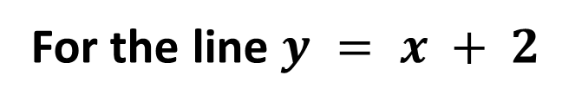
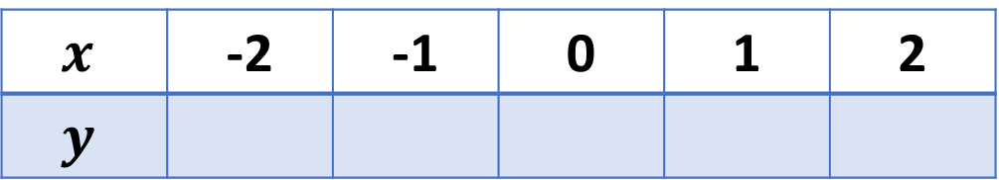
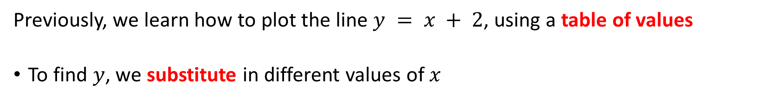
Activating Prior Knowledge
Previously, we learn how to plot the line $y = x + 2$, using a table of values
To find $y$, we substitute in different values of $x$
For the line $y = x + 2$
$$x$$ | -2 | -1 | 0 | 1 | 2
$$y$$
0
1
2
3
4

Slide 5
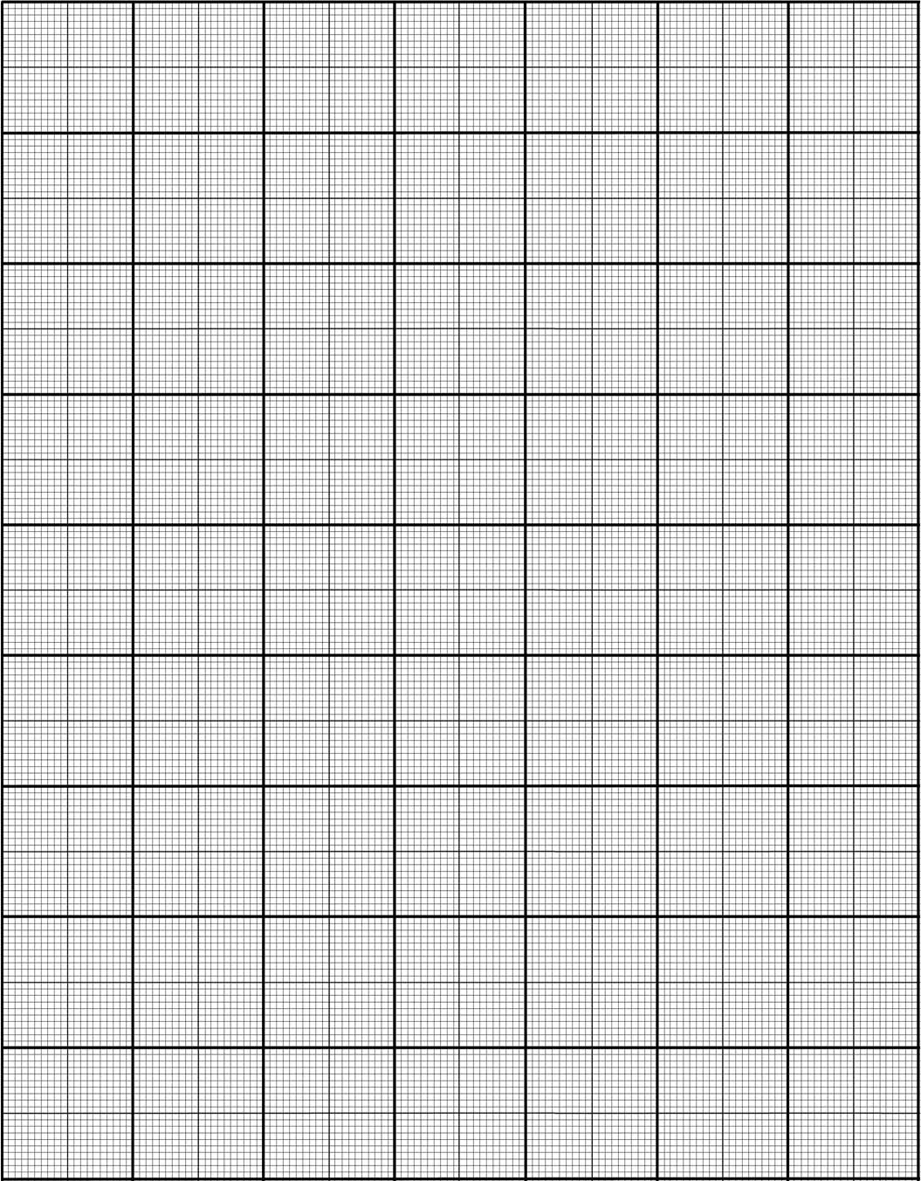
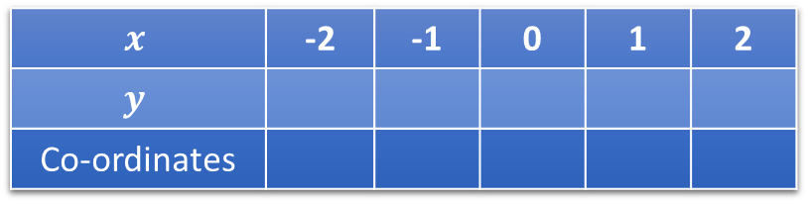
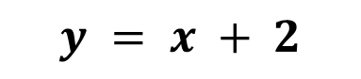
Guided Practice
y
$$y = x + 2$$
5
4
X
3
X
X
$$x$$ | -2 | -1 | 0 | 1 | 2
$$y$$
Co-ordinates
2
0
1
2
3
4
X
1
(-2, 0)
(-1, 1)
(0, 2)
(1, 3)
(2, 4)
X
X
-5
-4
-3
-2
-1
0
1
2
3
4
5
-1
-2
-3
-4
-5

Slide 6
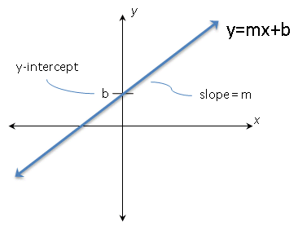
Lesson Importance
What does knowing the value of the gradient and y-intercept help us with?
Knowing the value of the gradient and y-intercept, allows us to easily graph a line without needing to plot many points

Slide 7
Concept Development
A linear equation can be written in two forms:
The gradient-intercept form where m = gradient & b = y-intercept:
y = mx + b
y = 3x – 2 (gradient = m = 3 and y-intercept = -2)
y = 4x + 7 (gradient = m = 4 and y-intercept = 7)
The general form where all terms are moved to the left and equated to zero:
y – mx – b = 0
y – 3x + 2 = 0 (in gradient intercept form will be y = 3x - 2)
y – 4x – 7 = 0 (in gradient intercept form will be y = 4x +7)

Slide 8
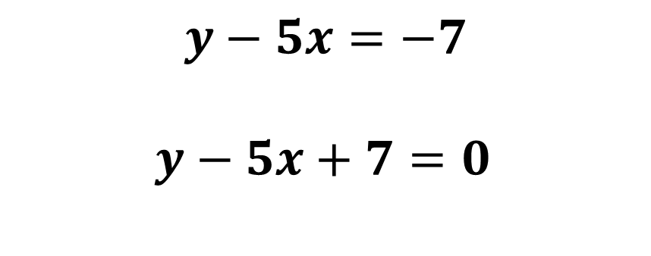
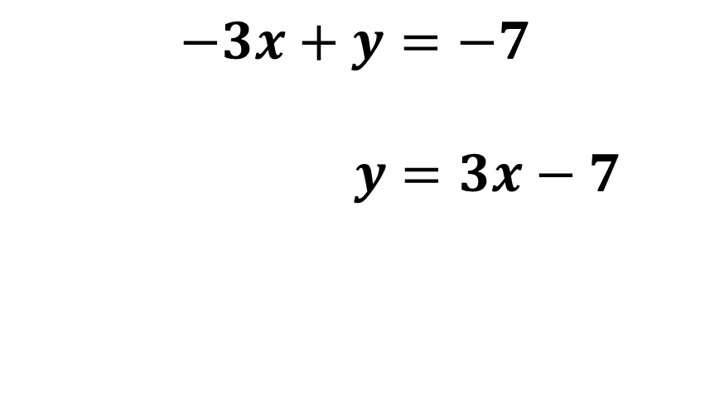
Guided Practice
Express -3x + y + 7 = 0 in the gradient-intercept form:
$$−3x+y=−7$$
$y=3x−7$
-7 from both sides
+3x to both sides
-3x + y + 7 = 0 in the gradient-intercept form will be y = 3x - 7
Express y = 5x – 7 in the general form:
$$y−5x=−7$$
$y−5x+7=0$
-5x from both sides
+7 to both sides
y = 5x – 7 in the general form will be y – 5x + 7 = 0

Slide 9
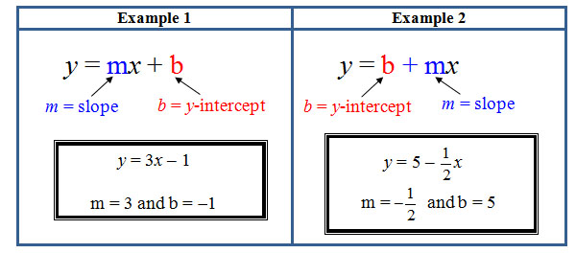
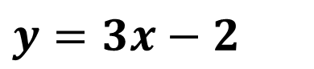
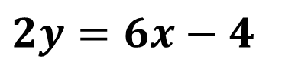
Guided Practice
State the gradient and y-intercept of the following linear equations:
2y = 6x - 4
In the equation 2y = 5x - 4, we need to arrange it into the gradient-intercept form:
$$2y=6x−4$$
Divide both sides by 2
$$y=3x−2$$
In the equation y = $3x−2,$ the gradient is 3 and the y-intercept is -2 or (0,-2)

Slide 10
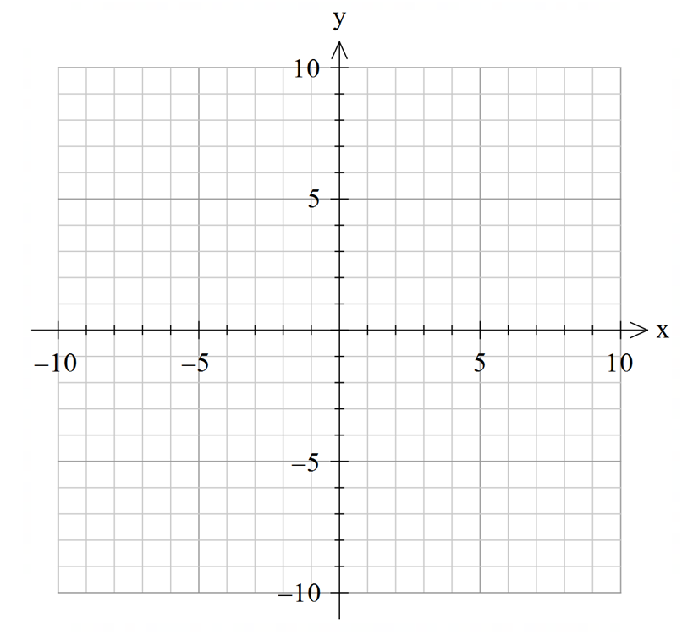


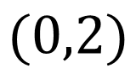

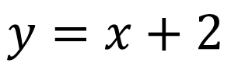
Guided Practice
S$ketch the graph y = x + 2$ using the gradient and $y−$intercept
Step 1: Write the coordinates of the $y−$intercept
$$y=x+2$$
Y-intercept : $(0,2)$
Step 2: P$lot the y−$intercept
Step 3: W$\text{rite} \text{the} \text{gradient} \text{as} \frac{rise}{run}=\frac{1}{1}$
$$(0,2)$$
Step 4: Start the y-intercept and move vertically the value of the rise (1)
Step 5: Move horizontally the value of the run(1) and place a point
Step 6: Draw a line through the points
Step 7: write the equation, label the y-intercept

Slide 11

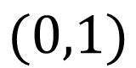

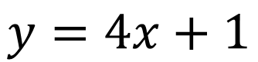
Guided Practice
S$ketch the graph y =4x +1$ using the gradient and $y−$intercept
Step 1: Write the coordinates of the $y−$intercept
$$y=4x+1$$
Y-intercept : $(0,1)$
Step 2: P$lot the y−$intercept
Step 3: W$\text{rite} \text{the} \text{gradient} \text{as} \frac{rise}{run}=\frac{4}{1}$
$$(0,1)$$
Step 4: Start the y-intercept and move vertically the value of the rise (4)
Step 5: Move horizontally the value of the run(1) and place a point
Step 6: Draw a line through the points
Step 7: write the equation, label the y-intercept

Slide 12



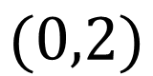

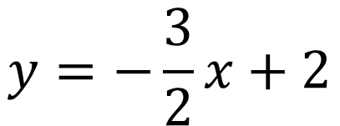
Guided Practice
S$ketch the graph 3x+2y=4$using the gradient and $y−$intercept
Step 0: Rearrange the equation
$$y=−\frac{3}{2}x+2$$
$$y=−\frac{3}{2}x+2$$
Step 1: Write the coordinates of the $y−$intercept
Y-intercept : $(0,2)$
Step 2: P$lot the y−$intercept
$$(0,2)$$
Step 3: W$\text{rite} \text{the} \text{gradient} \text{as} \frac{rise}{run}=\frac{−3}{2}$
Step 4: Start the y-intercept and move vertically the value of the rise (-3)
Step 5: Move horizontally the value of the run(2) and place a point
Step 6: Draw a line through the points
Step 7: write the equation, label the y-intercept

Slide 13
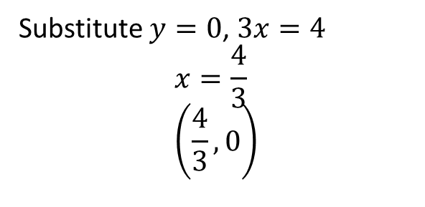
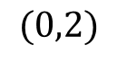

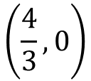
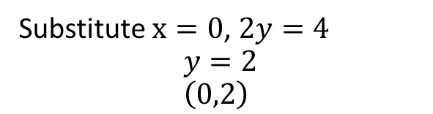
Guided Practice
S$ketch the graph 3x+2y=4$using the $x−$ and $y−$intercept
Step 1: Find the coordinates of $x−$ intercept
Substitute $y=0$, $3x=4$ $$x=\frac{4}{3} \\ \left(\frac{4}{3},0\right)$$
$$y=−\frac{3}{2}x+2$$
Step 2: Find the coordinates of $y−$ intercept
$$(0,2)$$
Substitute $x=0$, $2y=4$ $$y=2 \\ \left(0,2\right)$$
Step 3: P$lot the x−and y−$intercept
$$\left(\frac{4}{3},0\right)$$
Step 4: Draw a line through the points
Step 5: write the equation, label the x- and y-intercept

Slide 14
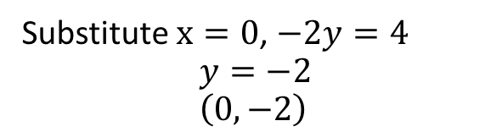
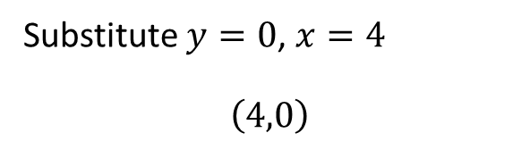
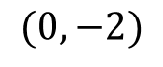
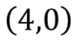
Guided Practice
S$ketch the graph x−2y=4$using the $x−$ and $y−$intercept
Step 1: Find the coordinates of $x−$ intercept
Substitute $y=0$, $x=4$ $$\left(4,0\right)$$
$$y=−\frac{3}{2}x+2$$
Step 2: Find the coordinates of $y−$ intercept
Substitute $x=0$, $−2y=4$ $$y=−2 \\ \left(0,−2\right)$$
$$\left(4,0\right)$$
Step 3: P$lot the x−and y−$intercept
$$(0,−2)$$
Step 4: Draw a line through the points
Step 5: write the equation, label the x- and y-intercept

Slide 15

Sketching using ClassPad Main
S$ketch the graph x−2y=4$

Slide 16
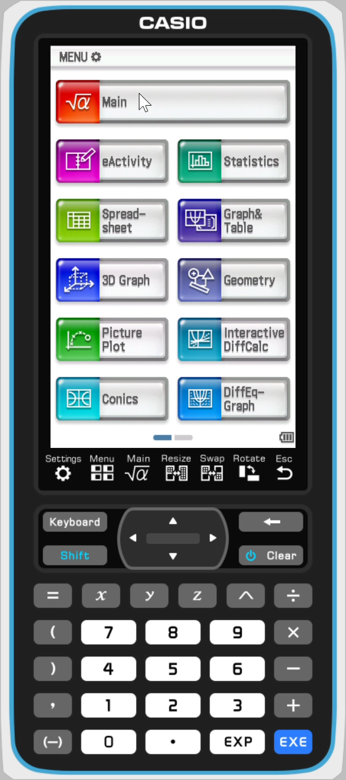
Sketching using ClassPad Graph
S$ketch the graph y=4x+1$

Slide 17
Guided Practice
Darrio borrowed $200 from his parents and agreed to repay $40 each week.
a) After 3 weeks, how much does Darrio still owe his parents?
b) Write an equation linking the amount Darrio owes his parents (A) with the number of weeks (n).
c) Find the amount owed when n = 0, and the number of weeks Darrio will take to repay his parents.

Slide 18
Independent Practice
Cambridge Ex 2D

